Slide 1
Prediction of online shoppers intention
Group-6
Notes:
© Copyright PresentationGO.com – The free PowerPoint template library

Slide 2
Introduction
Increase in the adoption and penetration of Internet has turned the online marketplace into an important distribution channel where consumers and businesses interact with each other.
The e-commerce usage has created the potential in the market but the need for customised promotions and alternatives to the customers have to be advanced.
As a result of this, many e-commerce companies invest in early detection and behavioural prediction systems which imitate the behavior of a salesperson in virtual shopping environment.

Slide 3
Data set info
The data belongs to the Gozlan group, a leading distribution company in Turkey.
We analyse and predict online shoppers intention, so that they can provide customized promotions to online shoppers.
Problem Statement:
To predict the customer’s intention about making transaction with various factors like duration in different pages , bounce/exit rates, page values etc.

Slide 4
Data dictionary
The dataset consists of 12330 records and 18 features.
It contains 10 numerical and 8 categorical attributes.
Numerical features
Categorical features
Features | Description
Administrative | No of pages-acc. management
Administrative_Duration | Time spent-acc. management
Informational | No of pages-Informational
Informational_Duration | Time spent-Informational
Product Related | No of pages-Product Related
ProductRelatedDuration | Time spent-Product Related
Bounce Rates | Avg bounce rate of pages visited
Exit Rates | Avg exit rate of pages visited
Page Value | Avg page value of pages visited
Special Day | Closeness of the site visiting time to a special day
Features | Description
Operating Systems | OS of the visitor
Browser | Browser of the visitor
Region | Region of the visitor
Traffic Type | Traffic source (banner , SMS etc.)
Visitor type | Visitor type as ‘‘New Visitor,’’ ‘‘Returning Visitor,’’ and ‘‘Other’’
Weekend(Boolean) | whether the date of the visit is weekend or not
Month | Month value of the visit date
Revenue(Boolean) | Class label indicating whether the visit has been finalized with a transaction

Slide 5
Pre Processing Data Analysis
There are no null values in the dataset.
Numerical variables analysis-Descriptive statistics:
Mean value is greater than median value for the following continuous features – Administrative, Administrative_Duration, Informational_Duration, Product Related, ProductRelated_Duration, Page Values
There is significant difference between 75th Percentile and maximum values of all the numerical features except two features-bounce rates and exit rates
Categorical variables analysis | Categories
Operating Systems | 8
Browser | 13
Region | 9
Traffic Type | 20
Visitor type | 3
Weekend(Boolean) | 2
Month | 12
Revenue(Boolean) | 2

Slide 6
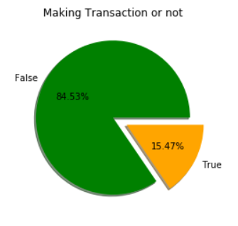
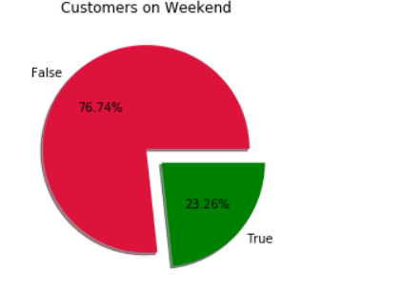
Exploratory Data Analysis
Usually weekends have higher customers. But here in our dataset, almost 3/4th of the customers are visiting website on week days
The dataset is imbalanced and only 15.47% are making transactions.

Slide 7
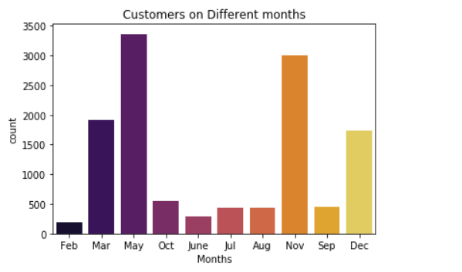
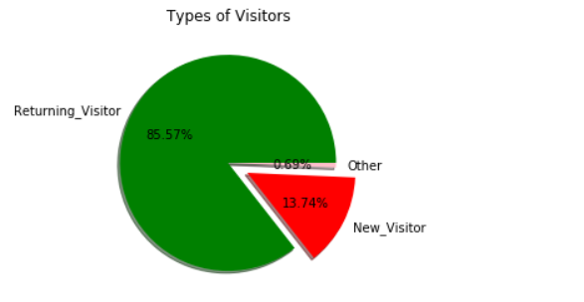
Exploratory Data Analysis
One of the top Turkish Traditional Festival (Ahirkapi Hidirellez Festival) is happening in May. Also national youth and sports day is celebrated in May.
The main religious festival of Turkey, Ramadan is also in or around May
The website is not having much new customers. Only 13.74% are new customers, while 85% are old customers.
So they can give some promotions to attract new customers.

Slide 8
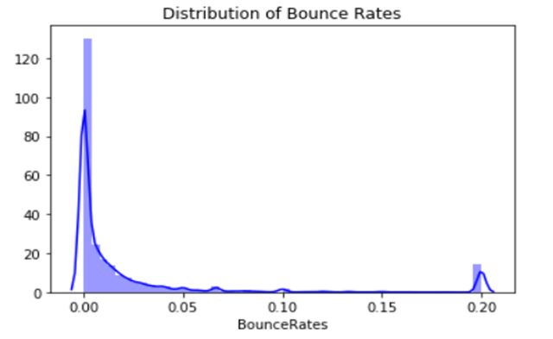
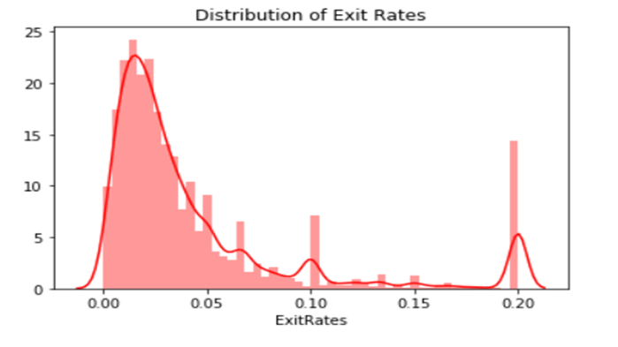
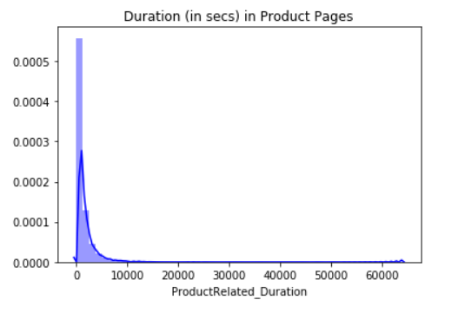
Exploratory Data Analysis
Bounce Rates, Exit Rates and Product pages are right skewed.

Slide 9
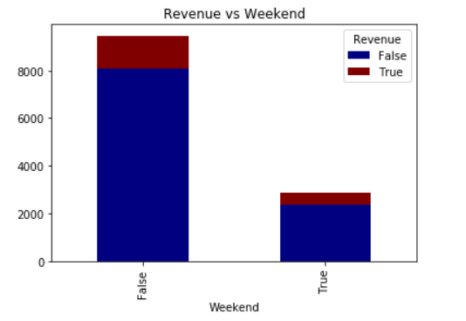
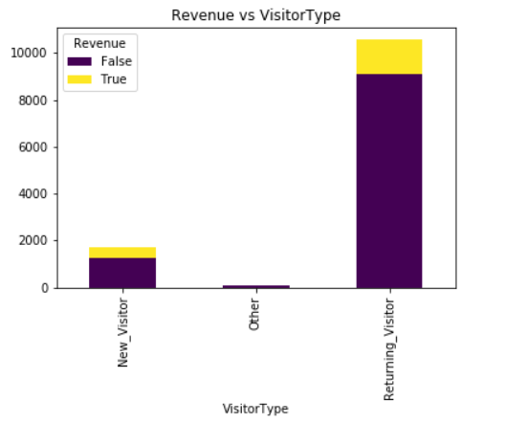
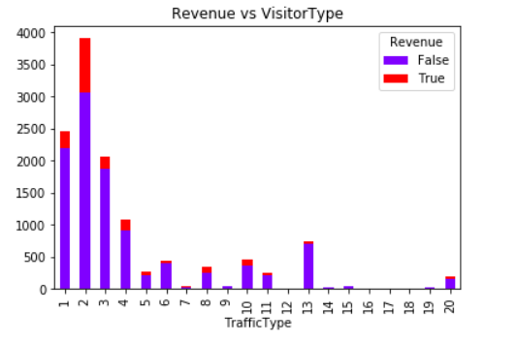
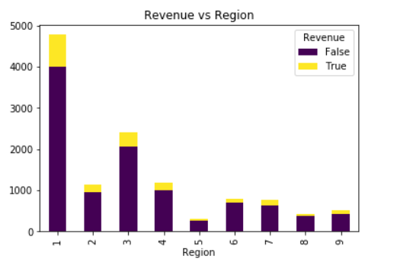
Exploratory Data Analysis

Slide 10
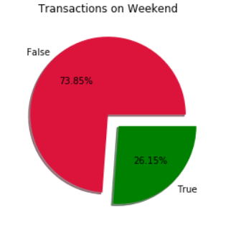
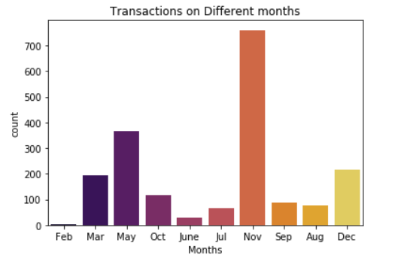
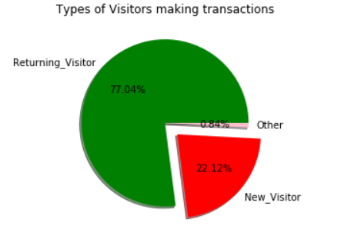
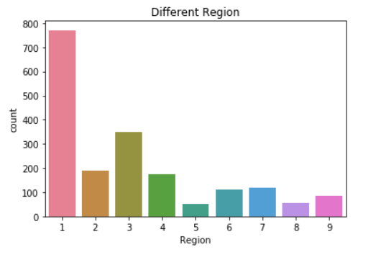
Exploratory Data Analysis

Slide 11
Exploratory Data Analysis
On plotting Operating System and browsers, OS 2 and Browser 2 are commonly used
When region was plotted , it was found that the website is common among region 1 customers. Promotions can be given in other regions to improve sales transactions
Traffic Source 2 is the best advertising source for the website. Should consider other sources and decide whether it is needed or not
Large number of outliers present in Administrative Duration, Informational Duration and Product Related Duration.
Even though more transactions are happening on week days, when comparing success rates weekends are better
Similarly when analyzing type of visitors, the success rate of new visitors is almost double of returning visitors
Low bounce rates and exit rates have higher tendency of making transactions
More customers are visiting website during May, but November is the month where maximum transactions are happening

Slide 12
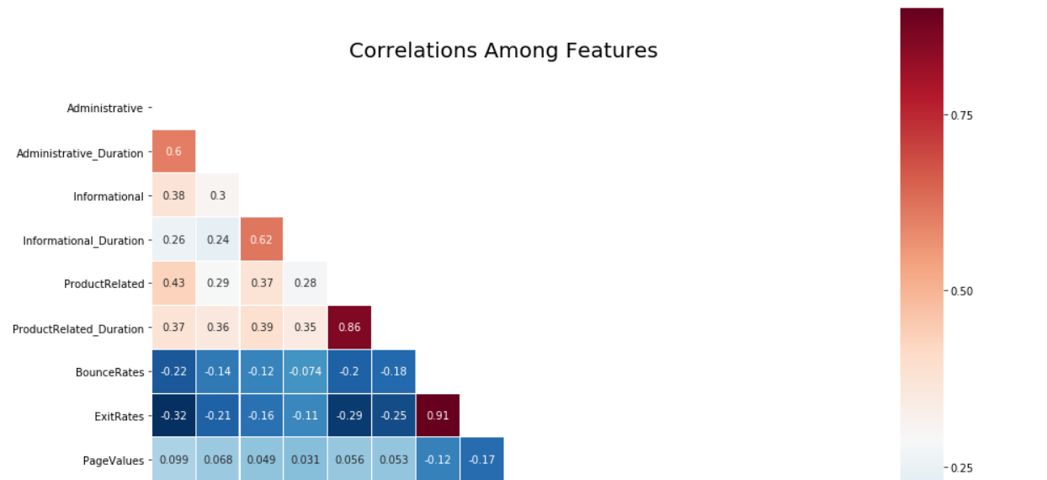
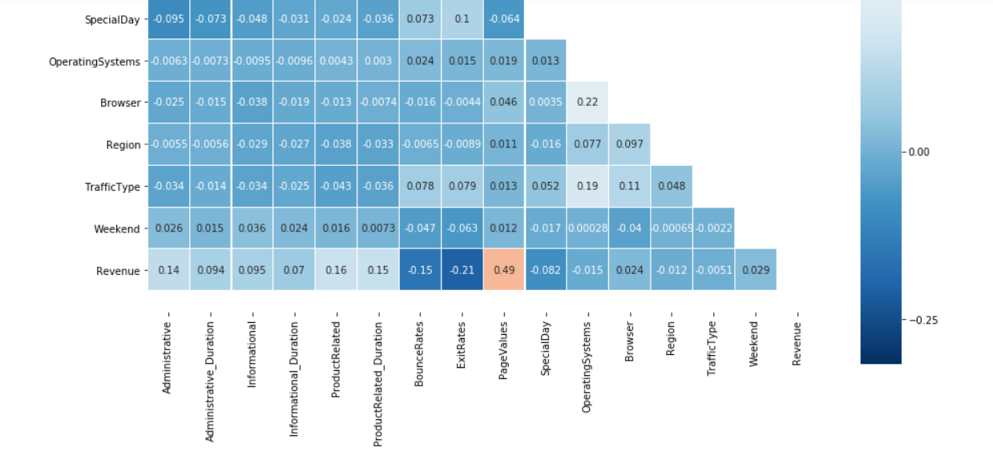
Multi-collinearity
Revenue is not having much collinearity with any of the features. Only Page Values is having a correlation of 0.49
But as expected administrative and administrative duration, informational and informational duration, product related and product related duration is having multi-collinearity. Also bounce rates and exit rates is also having a multicollinearity

Slide 13

Statistical Significance:
Features like Month, Operating Systems, Browser, Traffic type, Visitor type, Weekend are Significant among categorical variables.
Features like Administrative, Administrative_Duration, Informational, Informational Duration, Product Related, ProductRelated_Duration, Bounce Rates, Exit Rates, Page Values, Special Day are Significant among numerical variables.
Outliers detection:
Outliers were detected using boxplots.
Very high outliers are present in the features- Administrative Duration, Informational Duration and Product Related Duration
Feature Selection:
As the collinearity is high among administrative and administrative duration, we choose one variable among that.
Similarly informational duration and product related duration are chosen based on high collinearity with other variables.
We will remove region as it fails in the statistical test

Slide 14
Imbalanced dataset:
Only 15.47% are making transactions and the data is imbalanced.
SMOTE was performed on the training dataset to balance the data.
Data preprocessing:
Label encoding:
Revenue, visitor type, Month and weekend are label encoded.
Scaling:
Standard Scaler from sklearn module has been used to scale the data.

Slide 15
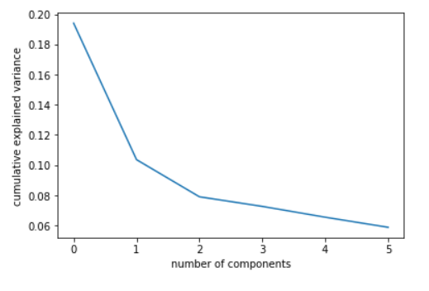
Dimensionality Reduction:
Principal component analysis was made and found that 6 components are best suited.
Assumptions on models:
Since our dataset contains 10 numerical and 8 categorical columns, Decision Tree or Random Forest will be best suited. Other possibility is Naive Bayes or can try bagging with decision trees

Slide 16
Base models:
Models built | Train score | Test score | Precision | Recall | F1 score | AUC Score
Logistic Regression | 88.59 | 87.38 | 87.38 | 87.38 | 45.59 | 65.45
Decision Tree | 100 | 85.07 | 85.07 | 85.07 | 53.15 | 72.21
Random Forest | 99.67 | 89.84 | 88.55 | 88.55 | 62.78 | 75.29
K Nearest Neighbours | 89.71 | 85.40 | 85.40 | 85.40 | 36.79 | 61.62
Naive Bayes | 85.06 | 84.72 | 84.72 | 84.72 | 51.79 | 71.33
Models built after SMOTE:
Models built | Train score | Test score | Precision | Recall | F1 score | AUC Score
Logistic Regression | 82.54 | 86.21 | 87.38 | 87.38 | 62.75 | 80.93
Decision Tree | 100 | 83.97 | 83.97 | 83.97 | 54.34 | 74.29
Random Forest | 99.98 | 88.74 | 88.55 | 88.55 | 68.13 | 83.52
K Nearest Neighbours | 92.92 | 81.05 | 81.05 | 81.05 | 53.87 | 76.46
Naive Bayes | 76.43 | 69.67 | 84.72 | 84.72 | 45.67 | 74.01

Slide 17
Models built after Hyper Parameter Tuning:
Models built | Train score | Test score | Precision | Recall | F1 score | AUC score
Logistic Regression | 82.54 | 86.21 | 87.64 | 87.64 | 62.75 | 80.93
Decision Tree | 95 | 84.59 | 84.94 | 84.94 | 59.36 | 79.06
Random Forest | 92.64 | 84.59 | 84.59 | 84.59 | 59.36 | 79.06
K Nearest Neighbours | 88.40 | 80.60 | 80.60 | 80.60 | 53.92 | 76.93
Naive Bayes | 76.43 | 69.67 | 69.67 | 69.67 | 45.67 | 74.01
Models built after cross validation-K-Fold:
Models built | Mean | Variance
Logistic Regression | 82.59 | 0.0046
Decision Tree | 86.04 | 0.0076
Random Forest | 86.24 | 0.0064
K Nearest Neighbours | 78.19 | 0.0042
Naive Bayes | 75.19 | 0.0019

Slide 18
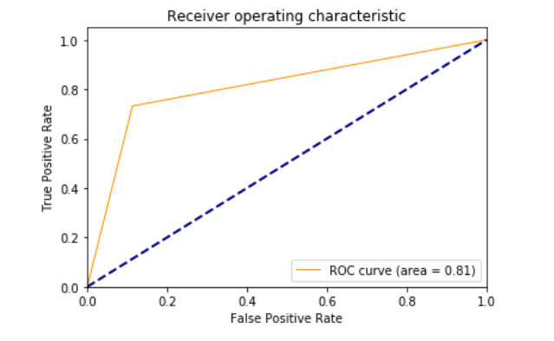
Confusion Matrix: ROC CURVE
 | 0 Prediction | 1 Prediction
0 Actual | 2300 | 294
1 Actual | 131 | 358

Slide 19
Business Interpretation
 | 0 Prediction | 1 Prediction
0 Actual | 750 | 90
1 Actual | 40 | 120
Out of 1000 customers our model correctly predicted the intention of 870 customers.
On an average, an individual spends almost $600 per year on e-commerce and company spends $100 on promotions per person.

Slide 20
Business Recommendations:
The website is common among the region 1. So promotions can be made more in other regions so that the transaction count can be increased.
When comparing the traffic sources 7,9,12, and 14 to 19 are not very profitable. So the company can decide on these sources.
The success rate of new visitors is very high compared to regular customers. So the company should make promotions to attract new customers.
More customers are visiting the website during the month of May but the transactions made are less.
The exit rate is very high in the month of February. So attractive offers can be given in that particular month to increase the sales.

